Slide 1
Machine Learning
AIML CZG565
Ensemble Learning
Neha Vinayak
BITS – CSIS - WILP

Slide 2

Machine Learning
Disclaimer and Acknowledgement
These content of modules & context under topics are planned by the course owner Dr. Sugata, with grateful acknowledgement to many others who made their course materials freely available online
We here by acknowledge all the contributors for their material and inputs.
We have provided source information wherever necessary
Students are requested to refer to the textbook w.r.t detailed content of the presentation deck shared over canvas
We have reduced the slides from canvas and modified the content flow to suit the requirements of the course and for ease of class presentation
Slide Source / Preparation / Review:
From BITS Pilani WILP: Profs.Sugata, Chetana, Monali, Rajavadhana, Seetha, Anita
External: CS109 and CS229 Stanford lecture notes, Dr.Andrew NG and many others who made their course materials freely available online

Slide 3
Course Plan
M1 | Introduction & Mathematical Preliminaries
M2 | Machine Learning Workflow
M3 | Linear Models for Regression
M4 | Linear Models for Classification
M5 | Decision Tree
M6 | Instance Based Learning
M7 | Support Vector Machine
M8 | Bayesian Learning
M9 | Ensemble Learning
M10 | Unsupervised Learning
M11 | Machine Learning Model Evaluation/Comparison

Slide 4
Random Forest

Slide 5
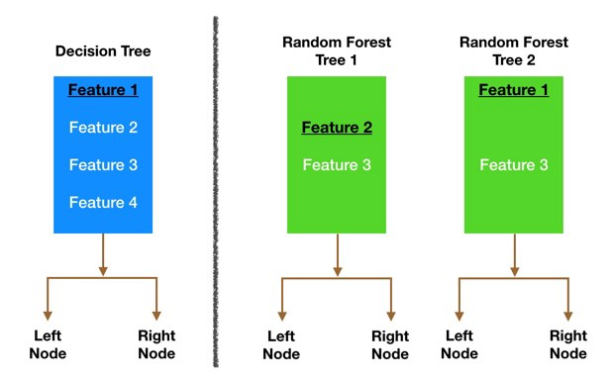

Random Forest
Ensemble method specifically designed for decision tree classifiers
Random Forests grows many trees
  Ensemble of unpruned decision trees
  Each base classifier classifies a “new” vector of attributes from the original data
  Final result on classifying a new instance: voting.
  Forest chooses the classification result having the most votes (over all the trees in the forest)
Lower correlation across trees
Image credit: https://medium.com

Slide 6
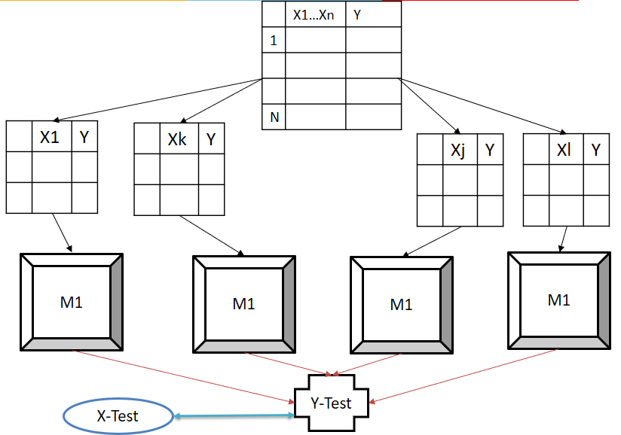
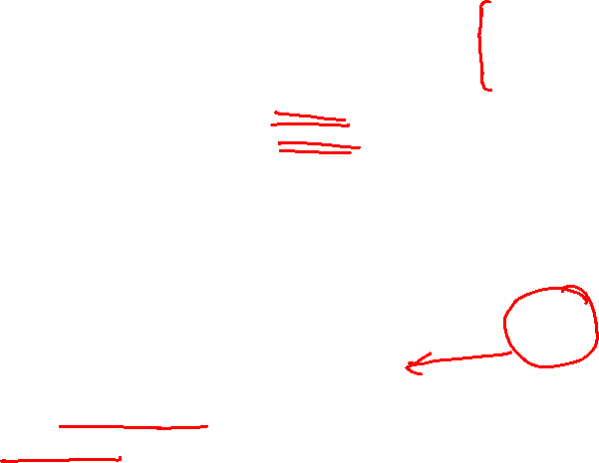
Random Forest Algorithm
Construct an ensemble of decision trees by manipulating training set as well as features
  Use bootstrap sample to train every decision tree (similar to Bagging)
  Use the following tree induction algorithm:
    At every internal node of decision tree, randomly sample p attributes for selecting split criterion
    Repeat this procedure until all leaves are pure (unpruned tree)

Slide 7
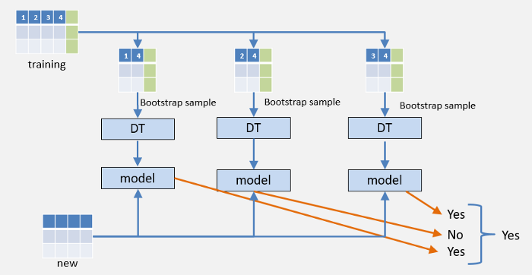
Random Forest
Trees that are trained on different sets of data (bagging)
Trees use different features to make decisions.
Image credit: https://medium.com

Slide 8

Random Forest
Random Forest need features that have at least some predictive power.
The trees of the forest and more importantly their predictions need to be uncorrelated (or at least have low correlations with each other).
Power to handle large data set with higher dimensionality.
It can handle thousands of input variables and identify most significant variables so it is considered as one of the dimensionality reduction methods.
Algorithm can solve both type of problems i.e. classification and regression

Slide 9
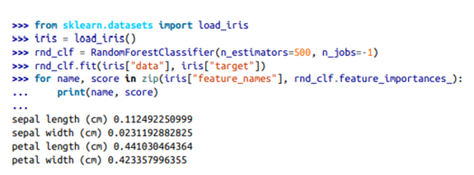
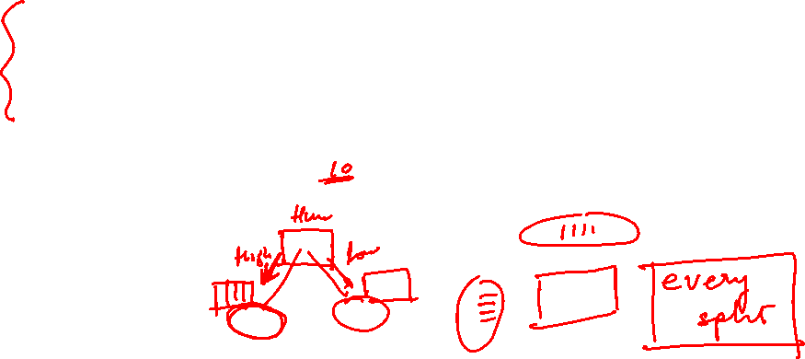
Random Forest
Cheaper Feature Selection

Slide 10
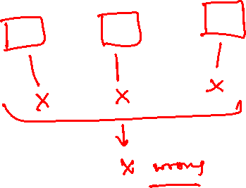
Boosting

Slide 11

Boosting
What if a data point is incorrectly predicted by the first model, and then the next (probably all models), will combining the predictions provide better results? Such situations are taken care of by boosting.
Boosting is a sequential process, where each subsequent model attempts to correct the errors of the previous model.

Slide 12
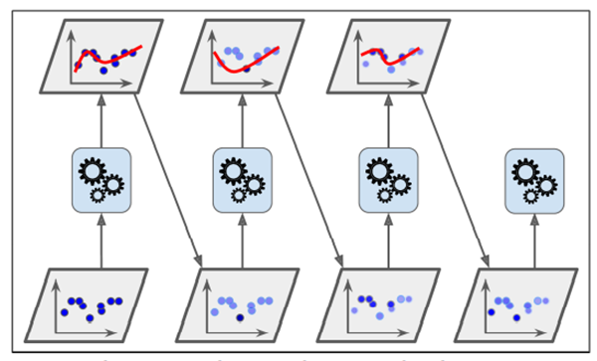
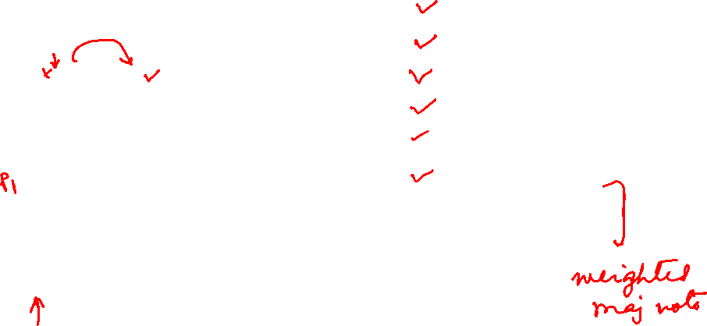
Boosting
Ada Boost
Initialization
Training the First Model
Evaluate Errors
Adjust Weights
Train a New Model
Combine Models
Iterate
Final Model

Slide 13
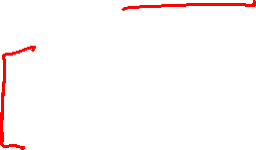
Boosting
Train predictors sequentially, each trying to correct its predecessor
Scalability
Ada Boost
An iterative procedure to adaptively change distribution of training data by focusing more on previously misclassified records
Initially, all N records are assigned equal weights (for being selected for training)
Unlike bagging, weights may change at the end of each boosting round

Slide 14
Boosting
Records that are wrongly classified will have their weights increased in the next round
Records that are classified correctly will have their weights decreased in the next round
Example 4 is hard to classify
Its weight is increased, therefore it is more likely to be chosen again in subsequent rounds

Slide 15
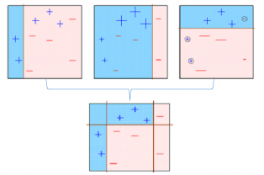
Boosting
Multiple models are created, each correcting the errors of the previous model.
The final model (strong learner) is the weighted mean of all the models (weak learners).
Individual models would not perform well on the entire dataset, but they work well for some part of the dataset. Thus, each model actually boosts the performance of the ensemble.

Slide 16
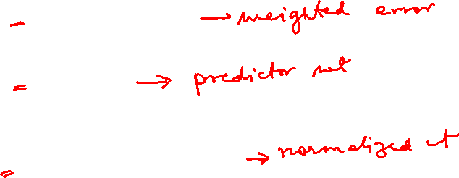
Ada Boost - Adaptive boosting Algorithm
For every instance j : w^{(j)} = 1/n
For every predictor/model/estimator i :
Sample D_{i} instances using bagging
Fit a classifier
Compute the weighted error rate of the predictor on all instances:
Compute the predictor’s weight
For every instance j:
Normalize all the instances weights

Slide 17
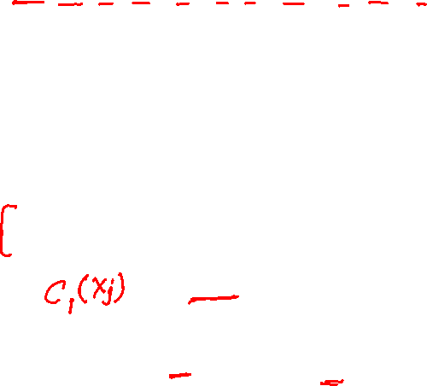
Ada Boost - Adaptive boosting Algorithm
Initially, all observations (n) in the dataset are given equal weights (1/n).
A model is built on a subset of data. Usually, decision trees are used for modelling.
Using this model, predictions are made on the whole dataset.
Errors are calculated by comparing the predictions and actual values.
Calculate the importance of the model
Weights can be determined using the error value. For instance, higher the error more is the weight assigned to the observation.
This process is repeated until the error function does not change, or the maximum limit of the number of estimators is reached.
Error rate: N input samples, (Averaging over weights of training examples of misclassified points)
x ≤ 0.75
True
False
y_{left} = -1
y_{right} =+1

Slide 18


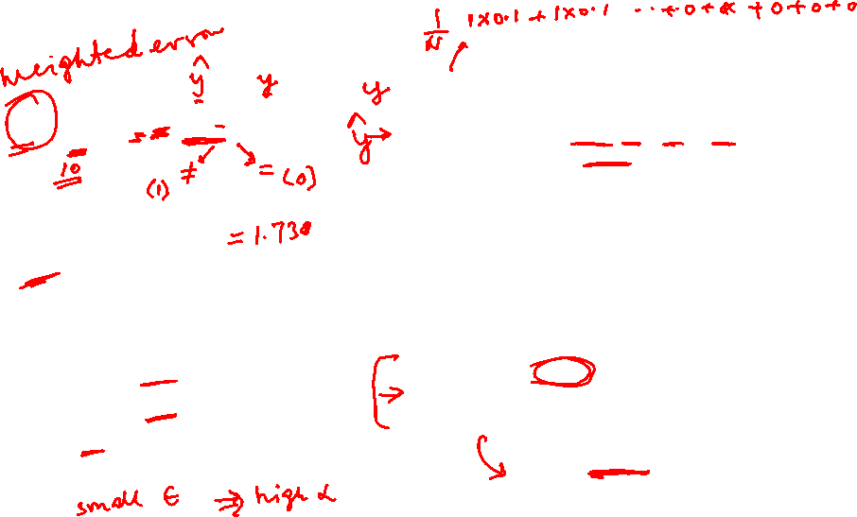
Ada Boost - Adaptive boosting Algorithm
Error rate: N input samples, (Averaging over weights of training examples of misclassified points)
x ≤ 0.75
True
False
y_{left} = -1
y_{right} =+1

Slide 19
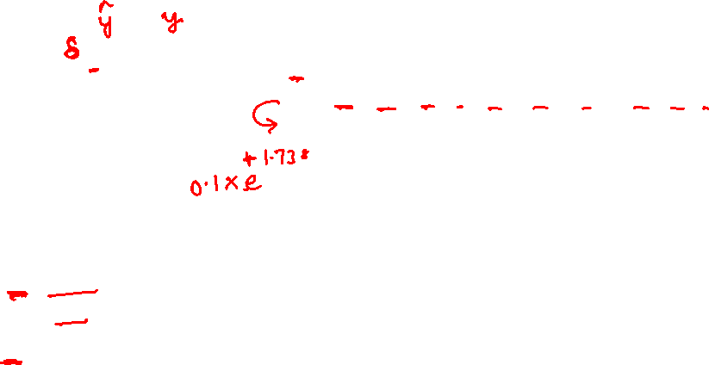
Ada Boost - Adaptive boosting Algorithm
Error rate: N input samples, (Averaging over weights of training examples of misclassified points)
x ≤ 0.75
True
False
y_{left} = -1
y_{right} =+1

Slide 20
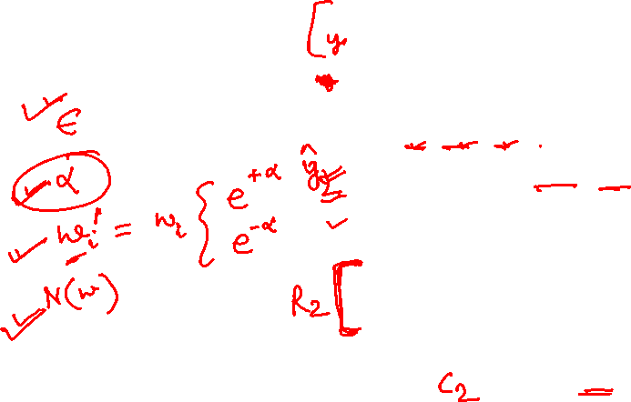
Ada Boost - Adaptive boosting Algorithm
x ≤ 0.05
True
False
y_{left} = -1
y_{right} =+1

Slide 21
Ada Boost – Weight Update
Weight Update:
<- Eqn:5.88
Reduce weight if correctly classified else increase
If any intermediate rounds produce error rate higher than 50%, the weights are reverted back to 1/n and the resampling procedure is repeated
Prediction:

Slide 22
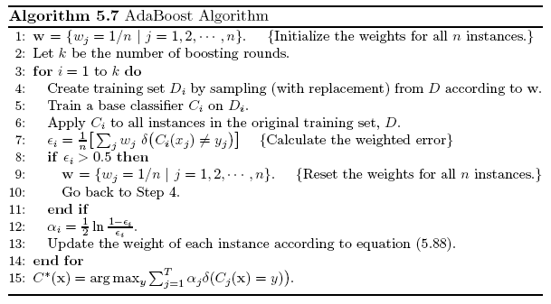
Ada Boost Algorithm – Version 1
(with bootstrapping + average of error term)

Slide 23

AdaBoost Example (version 1)
Training sets for the first 3 boosting rounds:
Summary:

Slide 24
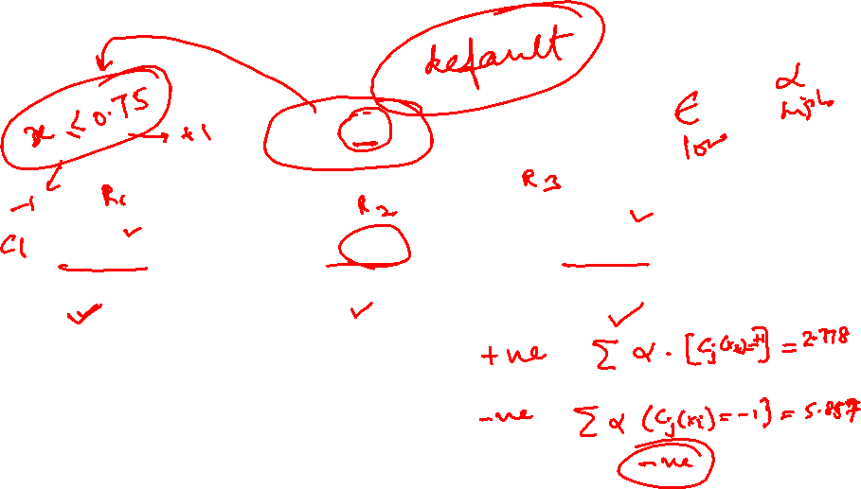
X-test = 0.65
α₁ | 1.7380
α₂ | 2.778
α₃ | 4.119
Y-test = -1
Y-test = +1
Y-test = -1
AdaBoost error function takes into account the fact that only the sign of the final result is used, thus sum can be far larger than 1 without increasing error

Slide 25
AdaBoost Example (Visualization)
Source Credit : Schapire and Freund, 2012

Slide 26
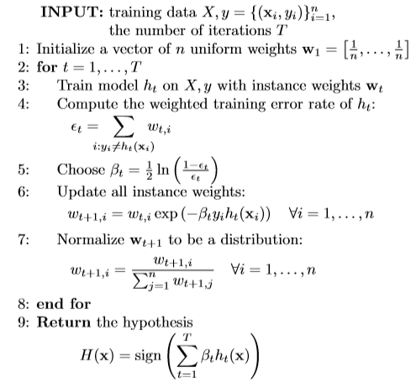
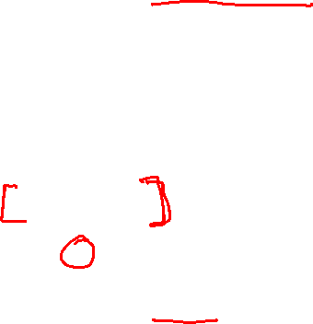
Ada Boost Algorithm – Version 2
(with bootstrapping + sum for error term)
Member classifier with less error are given more weight in ﬁnal ensemble hypothesis. Final prediction is a weighted combination of each members prediction

Slide 27
AdaBoost Example (version 2)
How do we combine the results now?
Source Credit : Schapire and Freund, 2012

Slide 28
AdaBoost Example (version 2)
Source Credit : Schapire and Freund, 2012

Slide 29
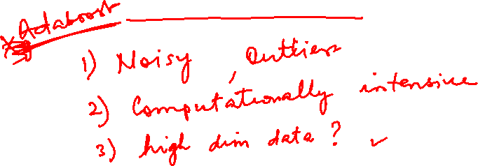
Gradient Boosting

Slide 30

Gradient Boosting
The idea of gradient boosting originated in the observation by Leo Breiman that boosting can be interpreted as an optimization algorithm on a suitable cost function
optimize a cost function over function space by iteratively choosing a function (weak hypothesis) that points in the negative gradient direction.
predictor can be any machine learning algorithm like SVM, Logistic regression, KNN , Decision tree etc. But Decision tree version of gradient boosting is much popular
In Gradient Boosting, "shortcomings” are identified by gradients.
Recall that, in Adaboost, “shortcomings” are identified by high-weight data points.
Both high-weight data points and gradients tell us how to improve our model.

Slide 31
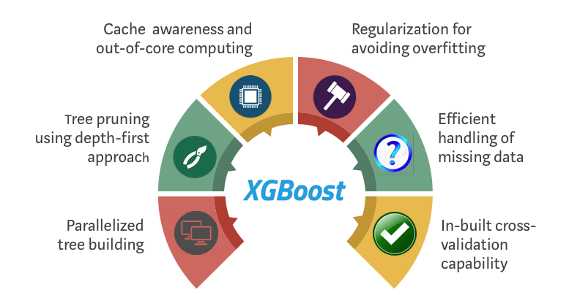
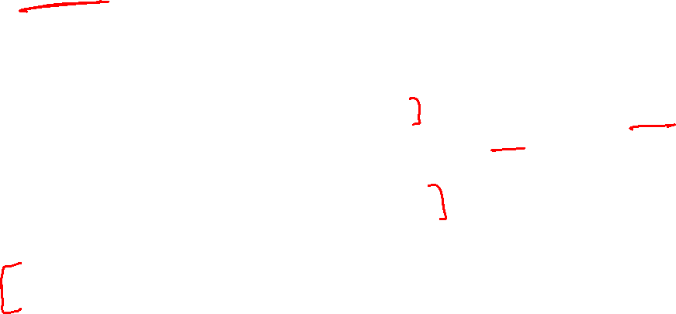
XGBoost
XGBoost (Extreme Gradient Boosting) uses the gradient boosting (GBM) framework at its core.
optimized distributed gradient boosting library designed to be highly efficient, flexible and portable

Slide 32
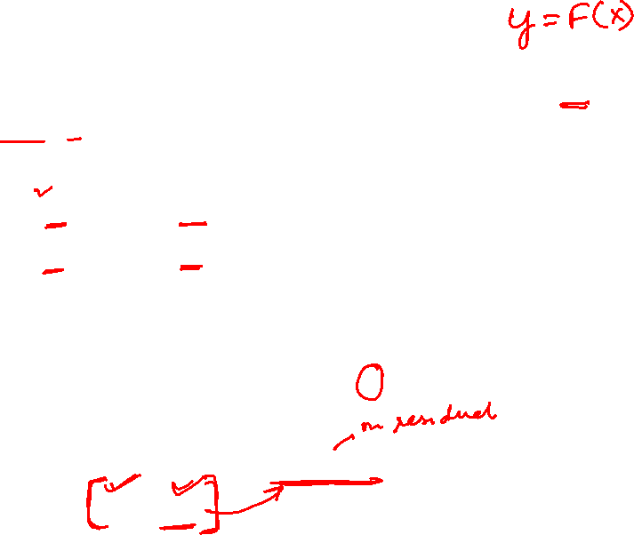
Gradient Boosting - Idea
You are given (x₁, y₁),(x₂, y₂), ...,(x_{n}, y_{n}), and the task is to fit a model F(x) to minimize square loss
There are some mistakes:
      F(x₁) = 0.8, while y₁ = 0.9,
      F(x₂) = 1.4 while y₂ = 1.3...
      How can you improve this model?
Rules:
  You are not allowed to remove anything from F or change any parameter in F.
  You can add an additional model (regression tree) h to F, so the new prediction will be F(x) + h(x).

Slide 33
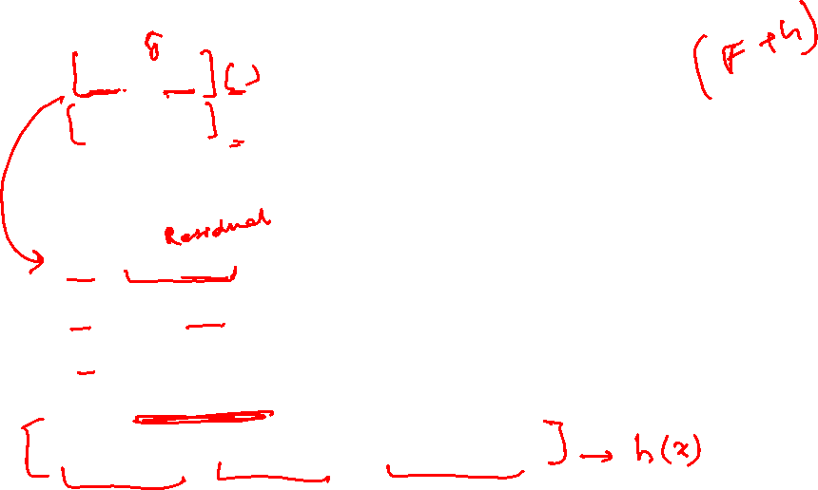
Gradient Boosting
You wish to improve the model such that
  F(x₁) + h(x₁) = y₁
  F(x₂) + h(x₂) = y₂ ...
  F(x_{n}) + h(x_{n}) = y_{n}
Or, equivalently
  h(x₁) = y₁ − F(x₁)
  h(x₂) = y₂ − F(x₂) ...
  h(x_{n}) = y_{n} − F(x_{n})
  Fit a regression tree h to data
  (x₁, y₁ − F(x₁)),(x₂, y₂ − F(x₂)), ...,(x_{n}, y_{n} − F(x_{n}))
Simple solution: y_{i} − F(x_{i}) are called residuals
These are the parts that existing model F cannot do well.
The role of h is to compensate the shortcoming of existing model F
If the new model F + h is still not satisfactory, we can add another regression tree...

Slide 34

Gradient boosting: Summary
Gradient boosting involves three elements:
  A loss function to be optimized
    For example, regression may use a squared error and classification may use logarithmic loss.
  A weak learner to make predictions E.g Decision tree/Decision stump
  An additive model to add weak learners to minimize the loss function.
    Trees are added one at a time, and existing trees in the model are not changed.
    A gradient descent procedure is used to minimize the loss when adding trees.
    Instead of parameters, we have weak learners
    After calculating the loss, to perform the gradient descent procedure, we must add a tree to the model that reduces the loss (i.e. follow the gradient).

Slide 35

Gradient boosting algorithm
let F₀ be a “dummy” constant model
for m = 1, . . . ,M
for each pair (x_{i},y_{i}) in the training set
compute the pseudo-residual R(y_{i}, F_{m-1}(x_{i})) = negative gradient of the loss
Train a regression sub-model h_{m} on the pseudo-residuals
Add h_{m} to the ensemble: F_{m}(x) = F_{m-1}(x) +ρ.h_{m}(x)
return the ensemble F_{M}

Slide 36
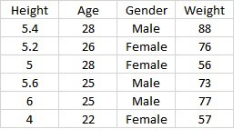
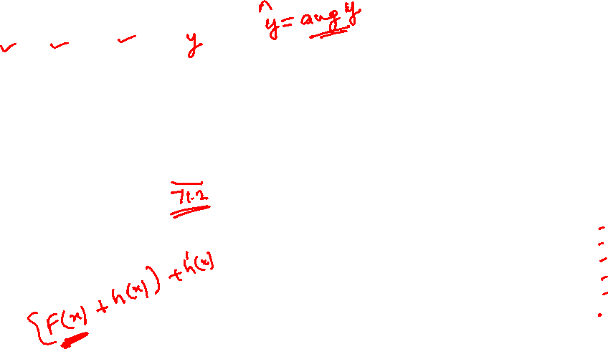
Gradient boosting: Example
F₀ be a “dummy” constant model
Average value is predicted.
Height | Age | Gender | Actual Weight | Predicted weight 1
5.4 | 28 | M | 88 | 71.2
5.2 | 26 | F | 76 | 71.2
5 | 28 | F | 56 | 71.2
5.6 | 25 | M | 73 | 71.2
6 | 25 | M | 77 | 71.2
4 | 22 | F | 57 | 71.2
Example credit: https://medium.com/nerd-for-tech/gradient-boost-for-regression-explained-6561eec192cb

Slide 37

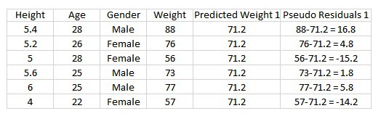
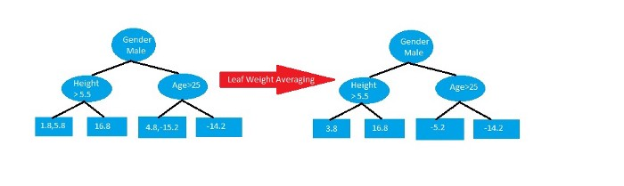
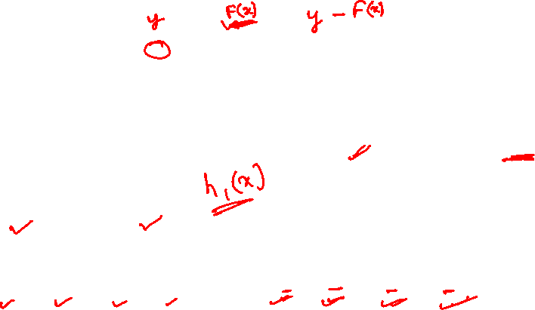
Iteration 1
compute the pseudo-residual R(y_{i}, F_{m-1}(x_{i})) = negative gradient of the loss
  Residual: h₁(x) = y − F₀(x)
A tree with maximum leaf nodes as 4(hyper parameter for DT) using Height, Age and Gender to predict the residuals(Error)
Example credit: https://medium.com/nerd-for-tech/gradient-boost-for-regression-explained-6561eec192cb

Slide 38
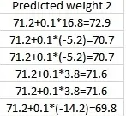
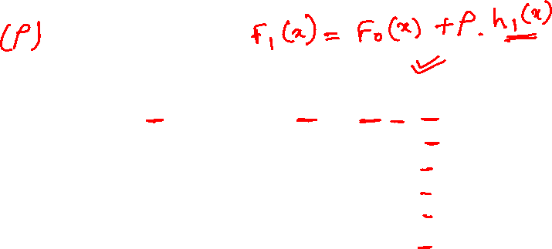
Iteration 1
Combining the trees to make the new prediction: F_{m}(x) = F_{m-1}(x) +ρ.h_{m}(x)
Learning rate : 0.1
F₁(x) = F₀(x) +ρ.h₁(x)
Example credit: https://medium.com/nerd-for-tech/gradient-boost-for-regression-explained-6561eec192cb

Slide 39
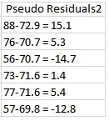
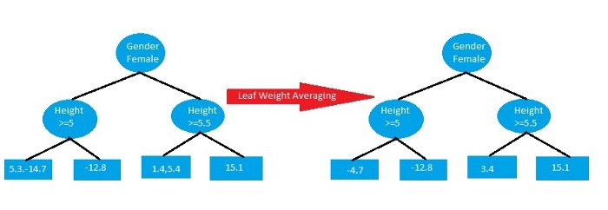

Iteration 1
  Residual: h₂(x) = y − F₁(x)
Example credit: https://medium.com/nerd-for-tech/gradient-boost-for-regression-explained-6561eec192cb

Slide 40
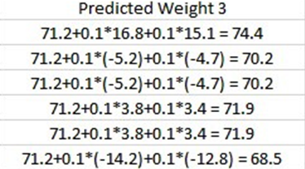
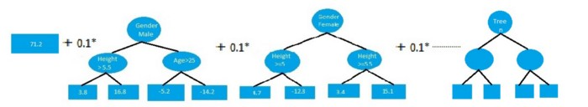
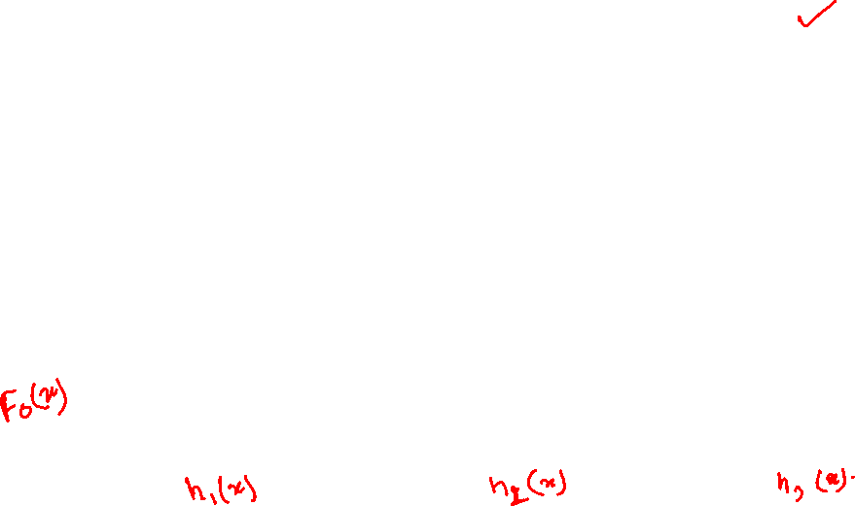
Iteration 2
Example credit: https://medium.com/nerd-for-tech/gradient-boost-for-regression-explained-6561eec192cb

Slide 41
References
Introduction to Data Mining, by Pang-Ning Tan, Michael Steinbach , Vipin Kumar
Bishop - Pattern Recognition And Machine Learning - Springer 2006
https://en.wikipedia.org/wiki/Gradient_boosting#:~:text=Gradient%20boosting%20is%20a%20machine,which%20are%20typically%20decision%20trees
https://medium.com/nerd-for-tech/gradient-boost-for-regression-explained-6561eec192cb
Unsupervised Learning
Next Session Plan

